Slide 1
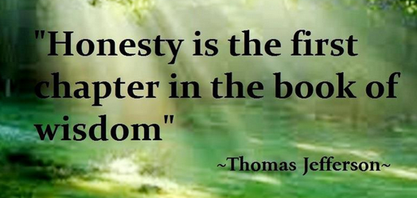
Honesty and Integrity
Ideas for Today and Tomorrow

Slide 2
Honesty:
The quality of being fair and truthful.

Slide 3
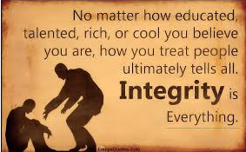
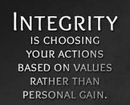
Integrity:
The quality of being honest and having strong moral principles. Following through with what you say.

Slide 4
Ways you can show these character traits!
Hold people accountable when their words do not match their actions.
Tell the truth, even if it will get you in trouble!
Say what you mean, and mean what you say.
Show up on time, every time.
Follow through on your promises.

Slide 5
Videos for Elementary School Students:
https://safeshare.tv/x/ss58b062ab5cc01
https://safeshare.tv/x/ss58b064e6c44d9

Slide 6
Videos for Middle and High School Students:
https://safeshare.tv/x/a8pwBxutfsM
https://safeshare.tv/x/ss58b062ab5cc01
https://safeshare.tv/x/ss58b064e6c44d9

